Slide 1
to the NLP-course “Getting to know your Unlimited Powers even better”
مرحبا
إمكانيات غير محدودة
Welcome!
دورة في البرمجة اللغوية العصبية
Dar al Amal, Ramallah, Palestine
third day Tuesday 25 October 2016
Trainers: Sytse and Marlies Tjallingii

Slide 2
Good and New
Energy
Joy
In pairs, 2 minutes each.
Focus at a recent situation which has given you a good/or new feeling. In which you felt energy, happiness or joy.
Share in the whole group the title of your experience and show your feelings at your face.

Slide 3
Open Frame
Questions
Experiences
Short stories
Share a real life-experience to reflect on what NLP can mean to it.
Goal: apply NLP in your own reality.

Slide 4
Presupposition no 12:
Failure doesn’t exist, only feedback
If what I do doesn’t give the desired result, then I do something different
If I always do what I always did,
then I get what I always got.
Failure Blaming K-
Feedback Learning K+

Slide 5
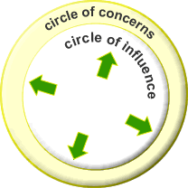
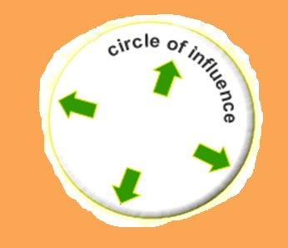
Cause and Effect
Cause
Effect
Standing at the side of the cause or the effect?

Slide 6
Exercise: Cause-Effect test
Aspect of communication | Mark every question with the answer that appeals most to you. | Score
What do you focus on? | Usually I am more focused on approaching.’ I often want to avoid problems. | 1A 1B
2. What do you think of? | First I think of the solution of a problem. First I think of the cause of a problem. | 2A 2B
3, Against or together? | I feel the other is against me and I think ‘they, you and everyone takes care of him/herself. I think in ‘we and together.’ | 3A 3B
4. Dealing with each other | There is talking about others, often blaming, the other does not need to be there. There is talking with each other, daring to confront each other (with respect). | 4A 4B
5. Helping or attacking? | The other will usually help me. It feels like others often want to attack me. | 5A 5B
6. Concept of humanity | People are interchangeable: "for you another." Each person has a unique contribution , | 6A 6B
7. Missing? | People will miss me and address me. No one will miss me. | 7A 7B

Slide 7
Anchoring
Anchor: Any stimulus that is associated with a specific response.
The short way to your resources
MOTIVATION
HUMOUR / LAUGHING
ENERGY
LOVE
POWER
SELFCONFEDENCE
Resources:

Slide 8
Chaining Anchoring
Making resources from the past available for the present.
Step 1
Write your own personal challenges / problematic situations:
My Personal Challenges
Challenging situation: | My example with the undesirable emotional present state in the past / or future (UPS): | My desired emotional future state (DFS):
Example: An encounter with someone who scares me

Slide 9
Experiences to anchor
Capture Positive moments
Category Anchor: | Anchor experience (concrete event with a desired emotional state): | Desired emotional state:
Visual (image): | (e.g., the daffodils in the park,) | e.g., admiration

Slide 10
Chaining Anchors
1
3
2
1
= UPS
4
2
= IS1
3
= IS2
4
= DFS
UPS -= Undisired Present State
IS1 -= Intermediate State 1
IS2 -= Intermediate State 2
DFS -= Disired Future State

Slide 11
Worksheet to practice chaining anchors
UPS Undesired Present State (unwanted)
.......................................................................................
IS1 Intermediate State 1 (required)
.......................................................................................
IS2 Intermediate State 2 (required)
.......................................................................................
DFS Desired Future State in final state
......................................................................................
knuckles
1 2 3 4

Slide 12
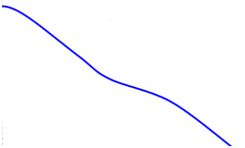
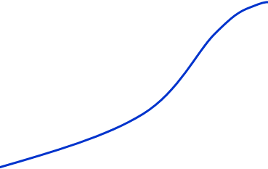
Anchoring
start
end
intensity
feelings
time
The four steps to anchoring
Remember a vivid positive experience from the past with one valuable resource as: Motivation; humour / laughing; energy; love; power; self confidence.
Press your knockel at the highest point (see graphic below).
Doe this with UPS, IS1, IS2 and FDS
Set the anchor in action to perform the test.

Slide 13
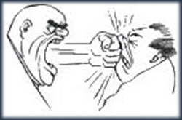
Swish pattern
Changing
size,
clearness, contrast

Slide 14
Swish patters
Changing Submodalities
smaller
contrast
S W I S H

Slide 15
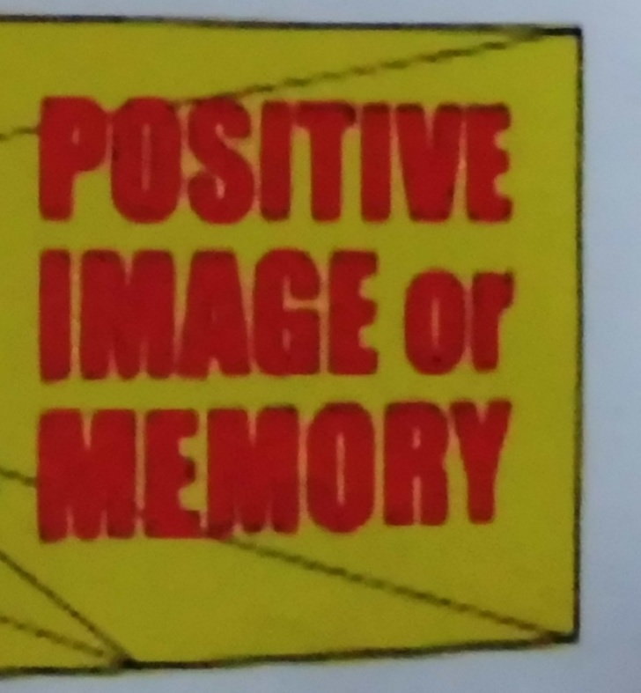

Slide 16
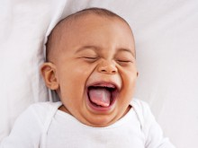
A positive memory enforce
meer contrast
groter
S W I S H

Slide 17
Blow away a negative memory
paler
smaller
smaller
paler
smaller
paler
smaller

Slide 18
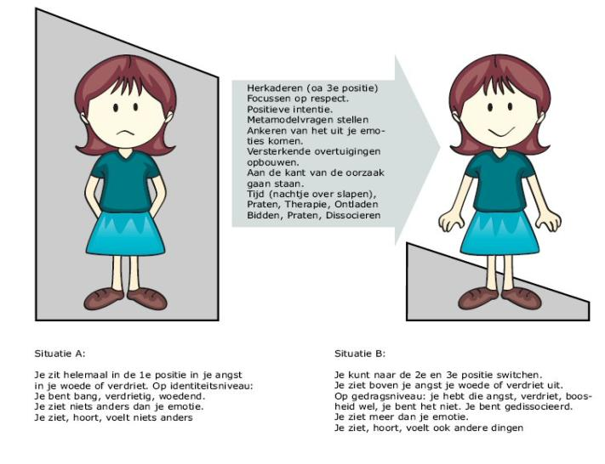
In de box Uit de box

Slide 19
UPS = Undesired Present Situation
DFS = Desired Future Situation

Slide 20
V = Value
Respect, Health, Love, Harmony, Freedom, Safety
Values and Beliefs
B
B
B
B
V
B
B
B
B
B
B
V
B
B
B
V
B
B
B
B- = Beliefs:
I can respect….. neighbors
B
B
I can respect ….. colleagues
B
V
B
V
B
B
B
B
B
B
V
B
B
B
B
B
B
B
V
B
V
B
B
B

Slide 21
Totally conscious
How are Values
organized in
our system?
Attitudes
Beliefs
Values
Core values
Meta Programmes
Totally unconscious

Slide 22
Sources of Values
Family
Friends
Religion
Sport
School
Music
Health
Living environment
Economy
Media
Nature
Community

Slide 23
Example of an important value:
Community
Game: the big wind blows

Slide 24
42 Exercise: Becoming aware of your values
A
Approach
B
Avoid

